Slide 1




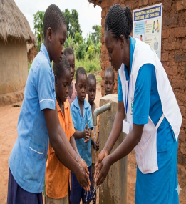
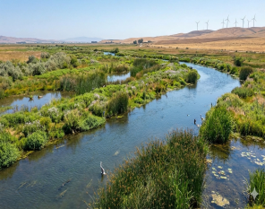
A
B
U
B
E
R
N
S
U
I
O
V
L
R
E
A
G
H
R
C
L
A
HONORARY PRESIDENTS
S
N
E
I
E
H
Y
H
K
PR. ABDELOUAHED CHALA, UNIVERSITY RECTOR
Management, protection and biodiversity conservation Team
LAMB Research Laboratory – Faculty of Life and Natural Sciences
HONORARY vice PRESIDENTS
PR. ABBOUDI ABDELAZIZ, DEAN OF SNV FACULTY
Organize :
CONFERENCE PRESIDENT
The First National Symposium
CONFERENCE TOPICS
DR. SEDRATI ABDENNOUR
TOPIC 1
The well-being of our planet and the health of its people are tightly connected. This symposium provides a leading venue for narrowing the divide between ecological integrity and public health, tackling the pressing challenges that arise where climate change, pollution, and disease prevention intersect. Attend with leading experts, researchers, and policymakers as we examine integrated approaches intended to strengthen ecosystem resilience and support safe places to live. Together, we will develop the strategies required to reduce environmental risks and secure a thriving future for everyone within a continually shifting global context.
Environmental Pollution, Emerging Contaminants and Human Health
HEALTH AND ENVIRONMENT
TOPIC 2
Water Quality and Innovations for Sustainable Management
TOPIC 3
15 December, 2026
Climate Change, Biodiversity, and Ecosystem Health
In-person seminar
El-hamma, KHENCHELA BP 1252, ALGERIA
FACULTY OF NATURAL AND LIFE SCIENCES, LABORATORY OF APPLIED MOLECULAR BIOLOGY (LAMB)

Slide 2



President OF THE ORGANIZING COMMITTEE
DR. HALASSI ISMAHAN
AUTHOR GUIDELINES
Abstract: max. 500 words (1 A4 page), margins 2.5 cm
Font: Times New Roman, Title: 14 (bold, centered), Text: 12 pt, line spacing: 1.5
Authors: bold, centered, 12 pt; Affiliation: Italic, 11 pt keywords : Max. 6, bold, 12 pt
PRESIDENT OF THE SCIENTIFIC COMMITTEE
PR. ELAFRI ALI
Dr. Saidi M
Dr. Yakhlef W
Dr. Athmani H
Dr. Badis M
Dr. Badis Z
Dr. Oueld ammar H
Dr. Mehamedi MR
Dr. Maamar H
Dr. Hanoun S
Dr. Boutarfi Z
Dr. Bousaa AH
Dr. Messai A
Dr. Bertella A
Dr.Bentaleb M
Dr. Aissani N
Dr. Mekersi N
Univ. Khenchela
Univ. Guelma
CRE. Annaba
Univ. El-oued
Univ. Guelma
Univ. OEA
Univ. Khenchela
Univ. Khenchela
Univ. Khenchela
Univ. Khenchela
NHSF Khenchela
Univ. Khenchela
Univ. Khenchela
Univ. Khenchela
Univ. Khenchela
Univ. Khenchela
Univ. Khenchela
NHSF Khenchela
Univ. Khenchela
Pr. Houha B.
Pr. Ghrieb L.
Pr. Tiar G.
Pr. Khezzani B
Pr. Houhamdi M.
Pr. Khemar H.
Pr. Elafri A.
Pr. Abbabsa N.
Dr. Halassi I.
Dr. Ferroudj s.
Dr. Aroua k.
Dr. Yahia M.
Dr. Aiche M. A.
Dr. Naili O.
Dr. Aliate T.
Dr. Larbaa R.
Dr. Dib D.
Dr. Chenaker H.
Dr. Mellal H.
POSTER FORMAT
Dimensions: 70 cm (width) × 90 cm (height), portrait orientation
Posters will be displayed in person
Abstract submission via:
https://sites.google.com/view/henv2026univ-khenchela/accueil
IMPORTANT DATES
Submission open: 25 October 2026
Abstract submission deadline: 25 November 2026
Acceptance notification: 05 December 2026
Conference date: 15 December 2026
Technical COMMITTEE MEMBERS
Registration fees
Boutaba nedjem Eddine
Bourmada naouel
Melkia Chaffai
Abdellaoui wided
Lachekhab djammila
Lachekhab beldia
Latreche samia
Tibellardjine Djemai
Lamouchi ali
PhD Student 2000DA
Teachers and researchers 4000DA
Professionals 6000 DA
henv2026@gmail.com

